Slide 1
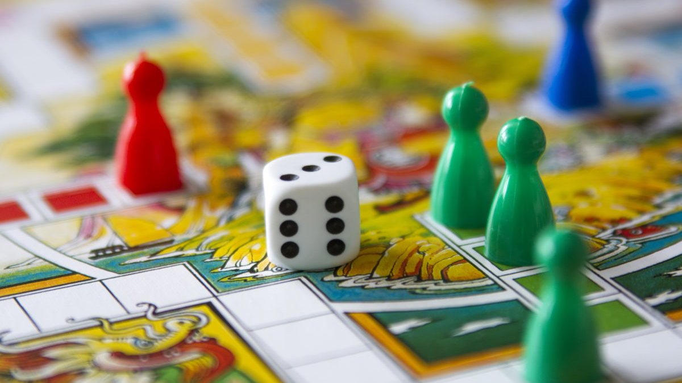
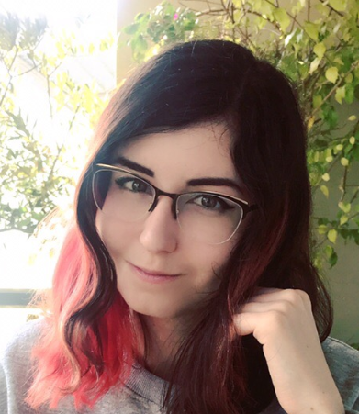
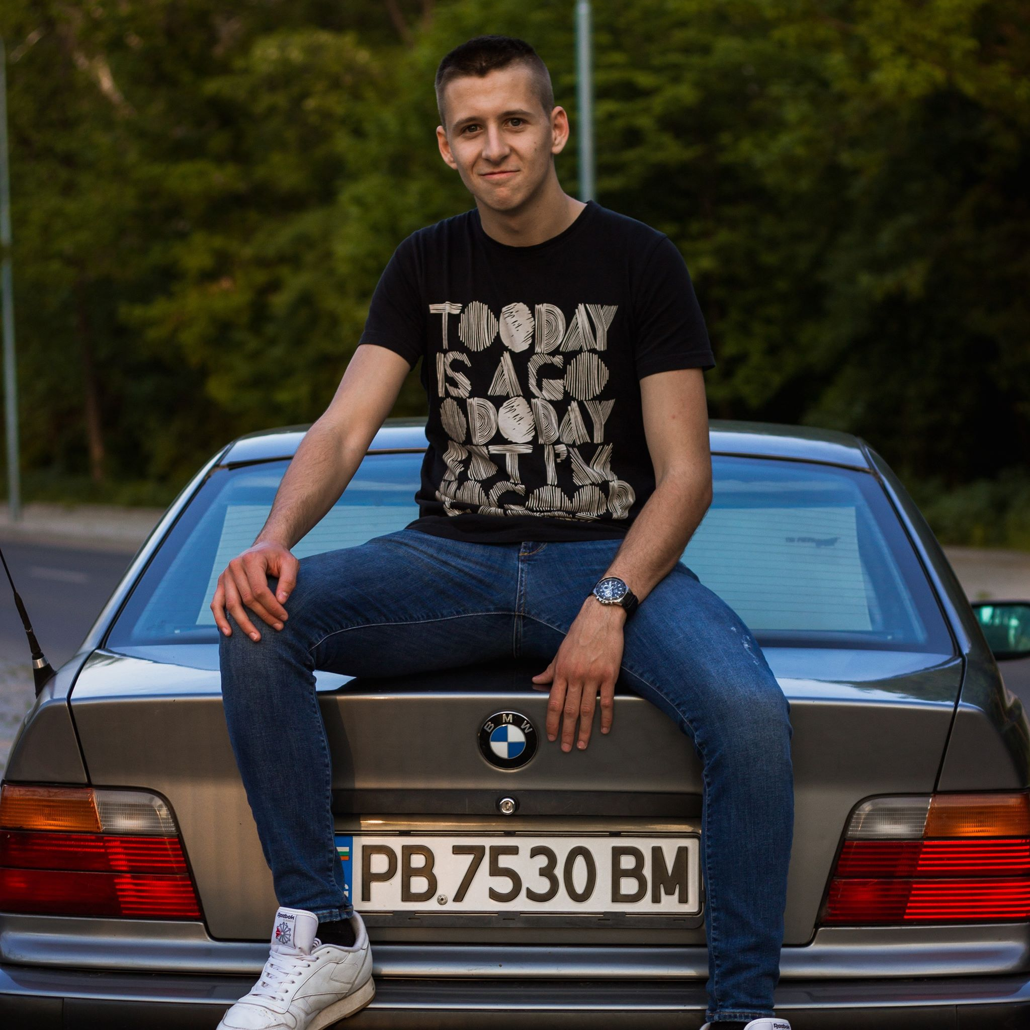
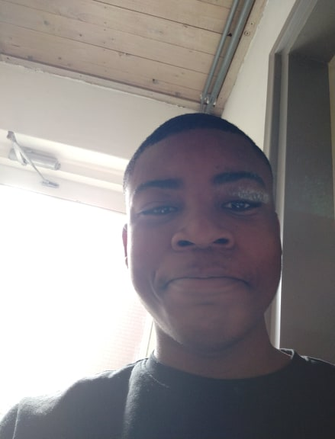
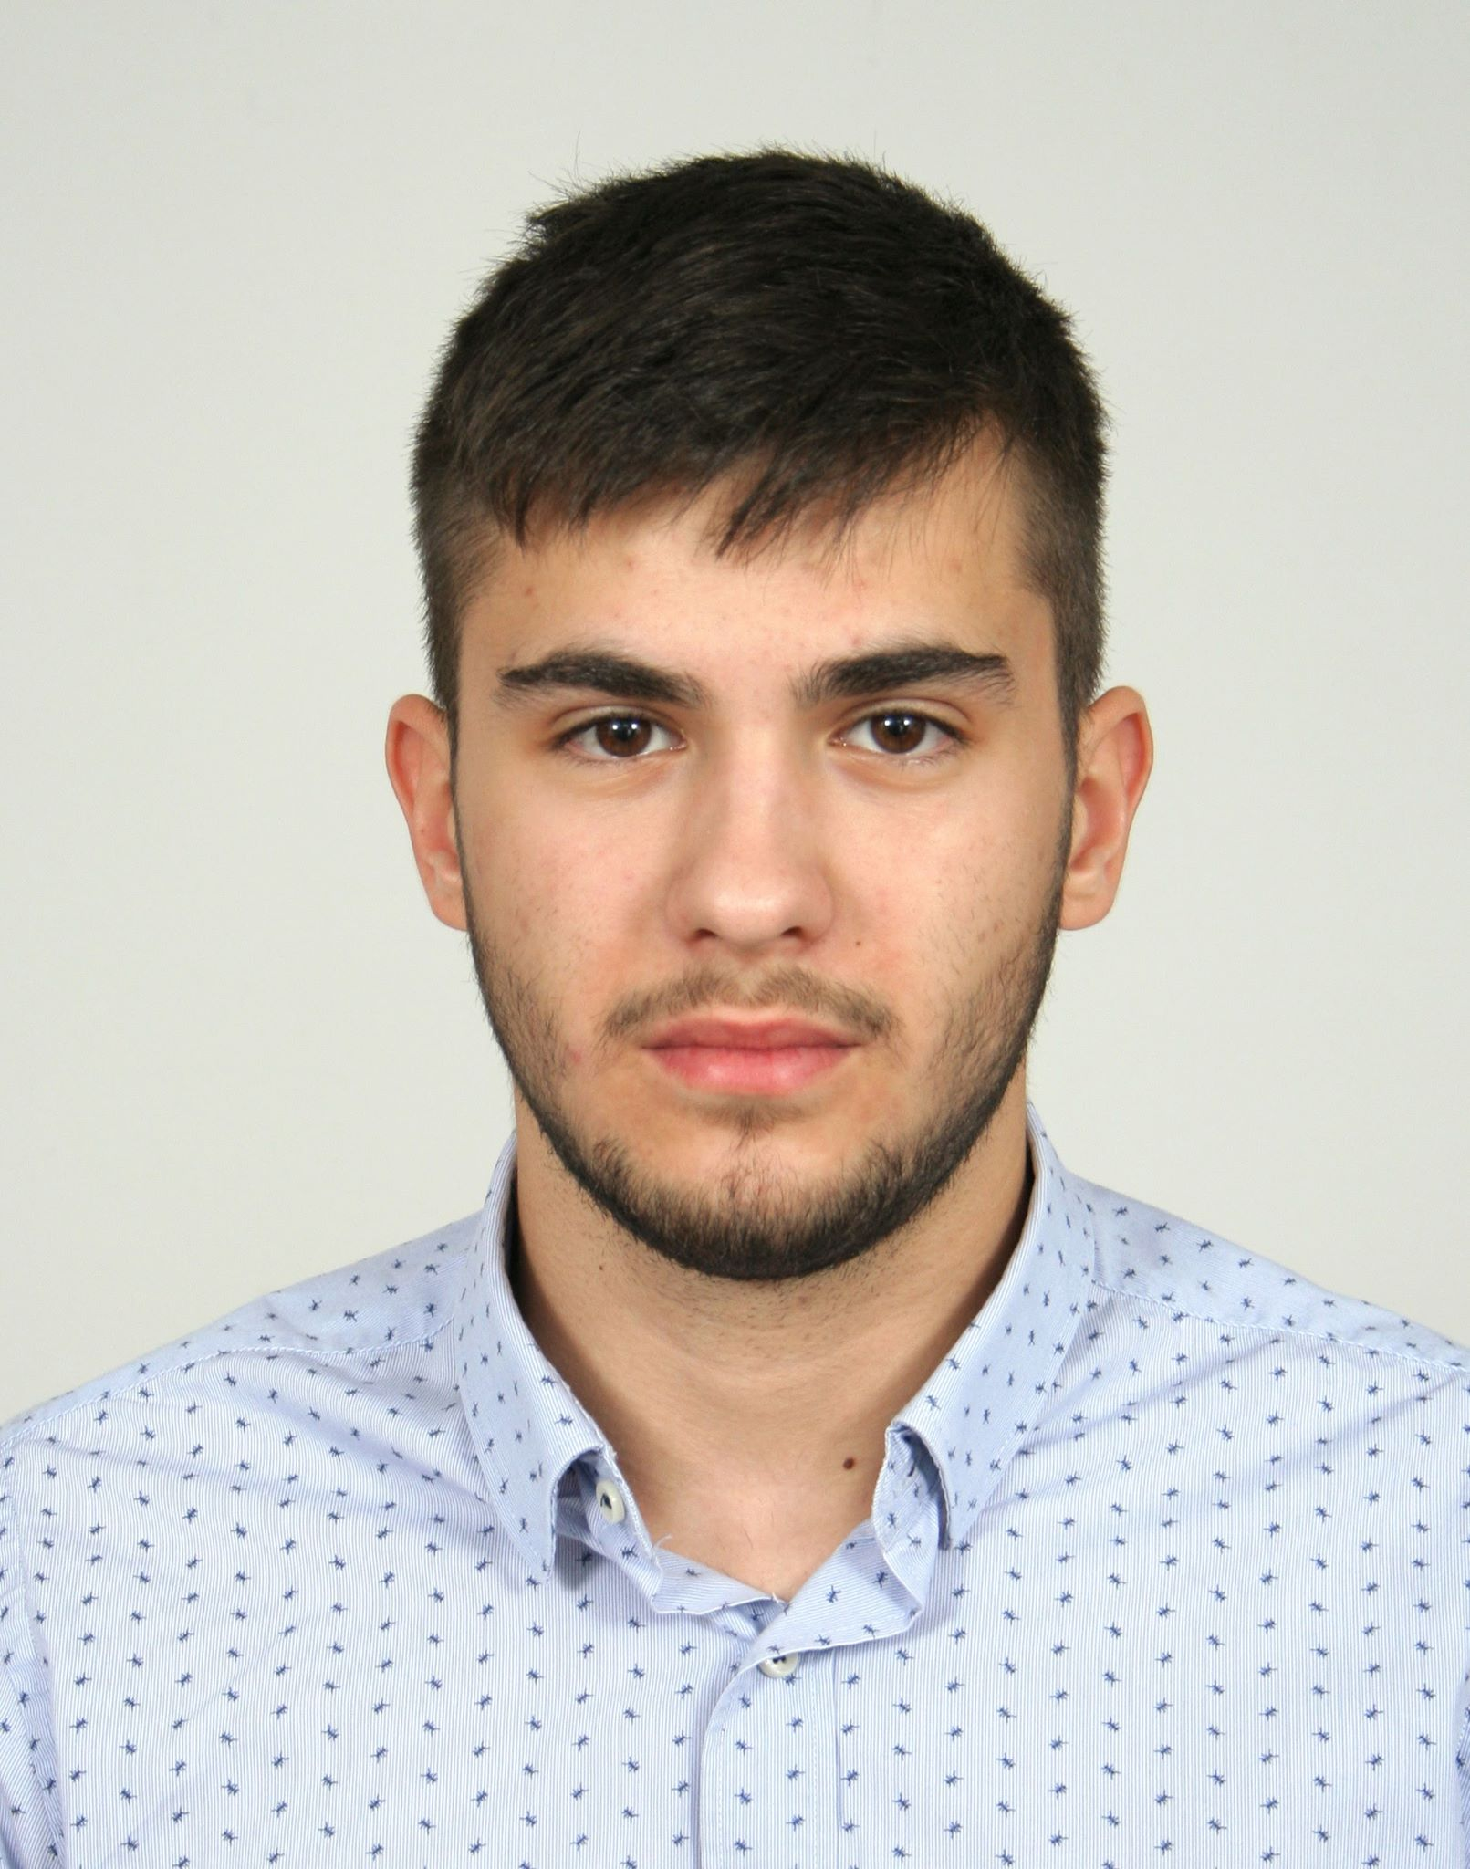
Team introduction
Maria Khovanskaya
e-b21
Dimitr Ivanov
e-s26
“Mad projects”
David Hooi
e-t21
Martin Grigorov
e-s22

Slide 2
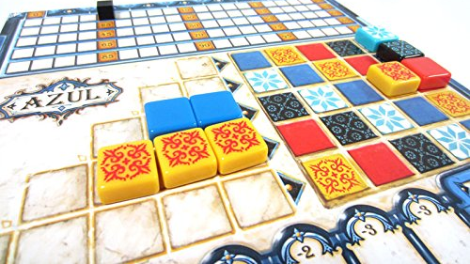
Introduction about the project
Steps:
Determine processes
Efficient automatization
Development
Testing
Website and applications for event management:
Tickets management
Purchases management
Rent management
Transactions management
Key values:
Usability
Scalability
Performance
Stability
Notes:
Usability – everything is comfortable and easy for user
Scalability – it’s easy to add new features or resize the project to bigger events or more events
Performance – everything runs fast and smooth

Slide 3
Website
Event pack
Website
Application
Used by visitors to:
Create an account (login/logout)
Purchase ticket (+ buy merch)
Top-up balance
Reserve a camp spot
Leave and read reviews
Contact event/developers
Used by employees to:
HERE PLZ ADD WHAT IT IS USED FOR BRIEFLY

Slide 4
Website
Why our website
Intuitively understandable interface
Most-used data stored in session (better performance)
User’s data input is always checked
Visitor receives QR ticket
Visitor can communicate with event via contact form
User can only access relevant pages
Fully tested
Based on existing event-management practices

Slide 5
Why our application

Slide 6
Personal impression: David

Slide 7
Personal impression: Martin

Slide 8
Personal impression: Dimitar

Slide 9
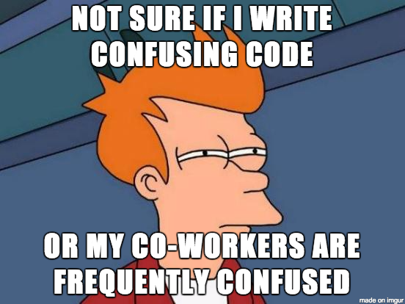
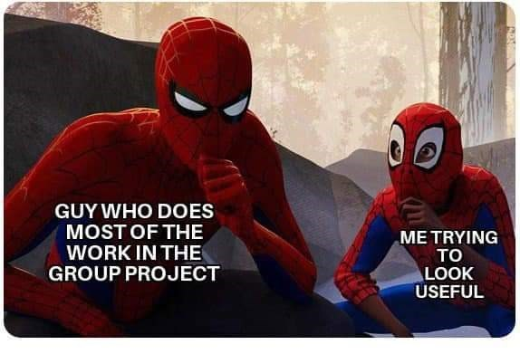
Personal impression: Maria
Interesting experience
A big project from meeting with client to production
Happy with result
Happy with awesome team

